Slide 1
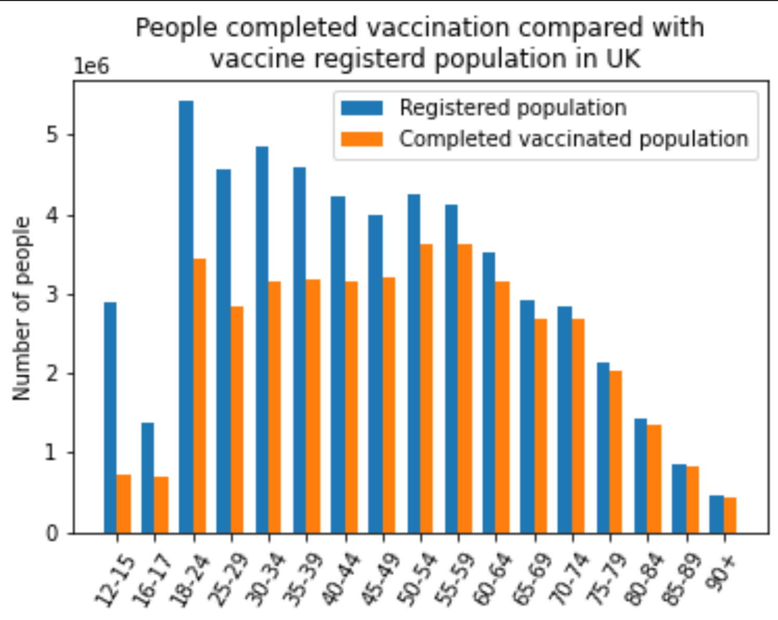
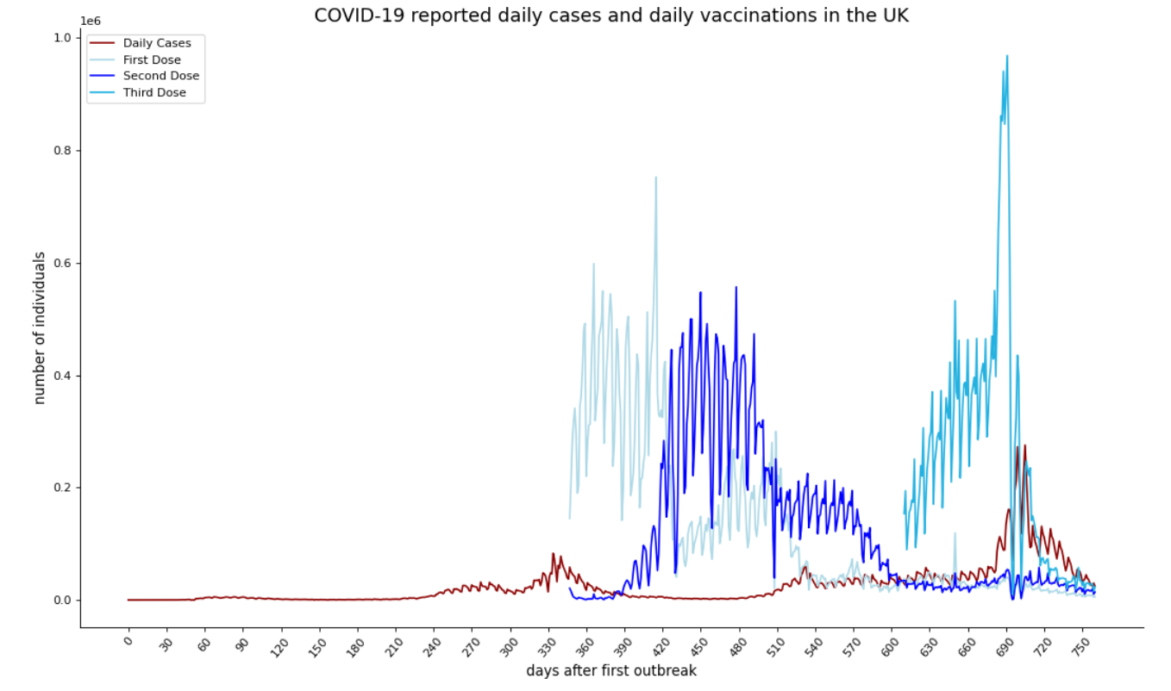
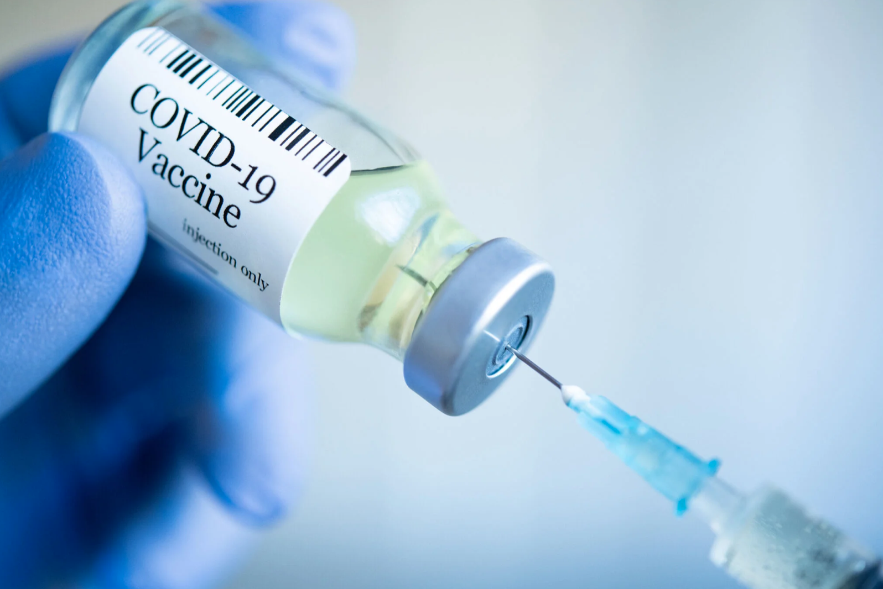
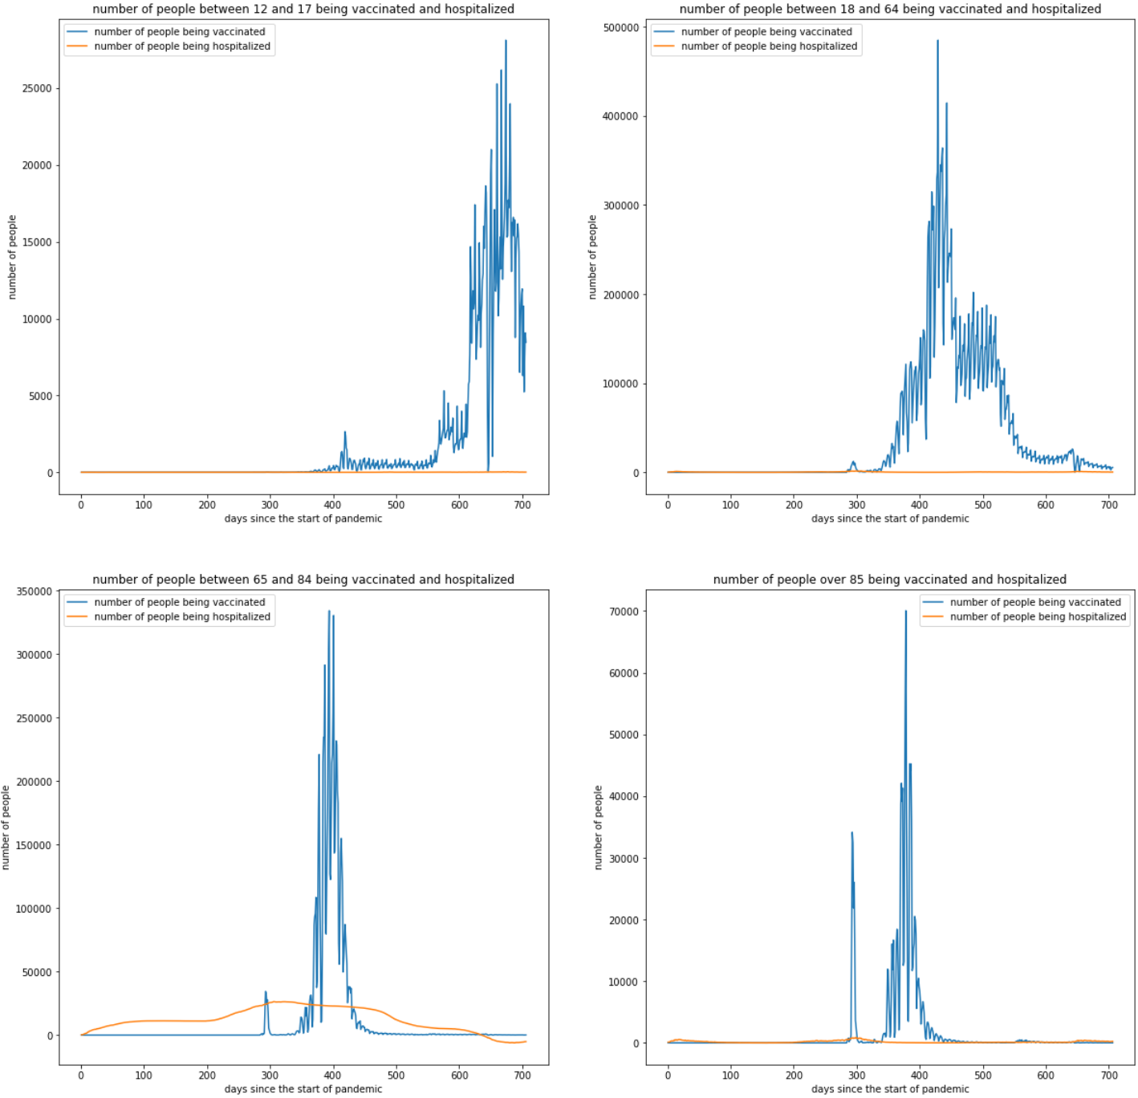
Validating efficacy of current COVID-19 vaccines on different age groups
Kinnman Nine, Nichakorn Pipatpadungsin (Pao), Jialin Liu (Lester), Christoforos Georgios Fistouris
INTRODUCTION
RESULTS
3. Proportion of people taking the vaccine in the UK
Since the first outbreak of COVID-19 and the start of the pandemic in the start of 2020, governments and various pharmaceutical companies around the world have collaborated for the development of vaccines against COVID-19. Various developed vaccines have shown to be effective in the protection against the disease.
Nonetheless, these statistics have changed with age and the emergence of variants of concern [2]. Also, it is still difficult to predict the effectiveness of the same vaccine administered to another population [1].
Therefore, in this project, we
aim to produce a statistical
model to measure an impact of
age as a factor in the vaccines’
effectiveness in protecting
against COVID-19.
1. Initial analysis using the real-world data
Figure 1. Daily reported cases of COVID-19 (red) and daily vaccinations in the UK (1st dose, 2nd and 3rd dose; blues), from beginning until 2 years after the start of the pandemic.
Figure 3. Bar chart showing the proportion of the UK population that took the vaccine compared to the registered population, based on their age group.
2. Vaccination and hospitalization for different age groups
4. Statistical analysis for vaccines in the SIR model
REASEARCH QUESTION
Can we get the same efficacy and effectiveness of the COVID-19 vaccines observed in the clinical trials using our statistical analysis and does it vary depending on the age of the population receiving it?
CONCLUSION/DISCUSSION
3 peaks of infection seem to have occurred during the last 2 years of pandemic.
Roughly starting at the end of the first year of the pandemic, first dose of vaccines started to be taken up, correlating with a drop in the rate of infections. The same can be observed for the second and third vaccine dose.
However, vaccination rate reaches their peaks before infection rate, could be explained by the time it takes to trigger and fully develop an immunity response.
The virus seems to not take a serious form in young people, based on the number of hospitalised people.
The proportion of older people (>50 years old) taking the vaccine is relatively higher than younger people.
Vaccination against COVID-19 is very effective in protecting older people from developing serious cases of the disease and being hospitalised for it.
METHODS
Data from the NHS website was retrieved and used to observe:
The number of cases and vaccinations in the UK
The cumulative number of vaccination and hospitalization
The proportion of people that got vaccinated in the UK
Using this data, different analysis were performed using Python.
pandas was used to import our data
numpy was used for statistical analysis
Matplotlib was used to plot clear diagrams
A modified SIR model was used for statistical analysis of vaccines efficiency
A
REFERENCES
1. Olliaro, P., Torreele, E. and Vaillant, M. (2021) COVID-19 vaccine efficacy and effectiveness—the elephant (not) in the room. The Lancet Microbe, 2(7), pp. e279–e280. doi: 10.1016/s2666-5247(21)00069-0.
2. Collier, D. A. et al. (2021) Age-related immune response heterogeneity to SARS-CoV-2 vaccine BNT162b2. Nature, 596(7872), pp. 417–422. doi: 10.1038/s41586-021-03739-1.
3. Banerjee, A. (2020) CanSino coronavirus vaccine shows immune response in human trial. Available at: https://www.reuters.com/article/us-health-coronavirus-cansinobio-idUSKCN24L1NP (Accessed 28 Feb 2022).
4. Boseley, S., Oltermann, P., Hopes rise for end of pandemic as Pfizer says vaccine has 90% efficacy. Available at: https://www.theguardian.com/world/2020/nov/09/covid-19-vaccine-candidate-effective-pfizer-biontech (Accessed 28 Feb 2022).
Figure 2. Proportion of population vaccinated and hospitalised in different age groups (in years): (A) 12-17, (B) 18-64, (C) 65-84 and (D) >85

